Slide 1

World Hotels
Fadil Idris Habeeb
22066955

Slide 2
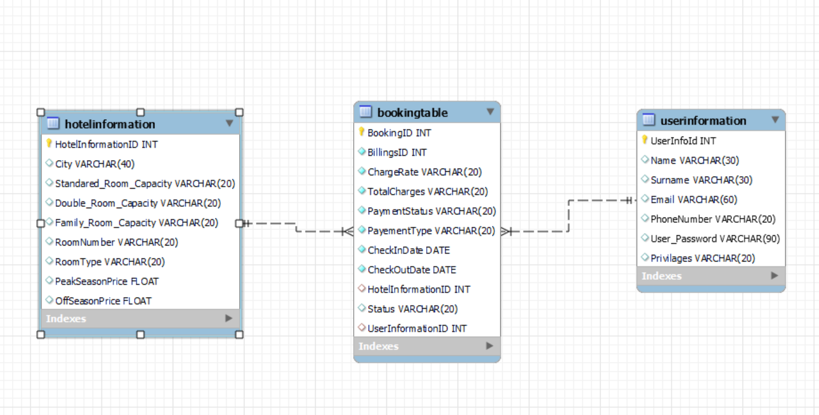
Database Design

Slide 3
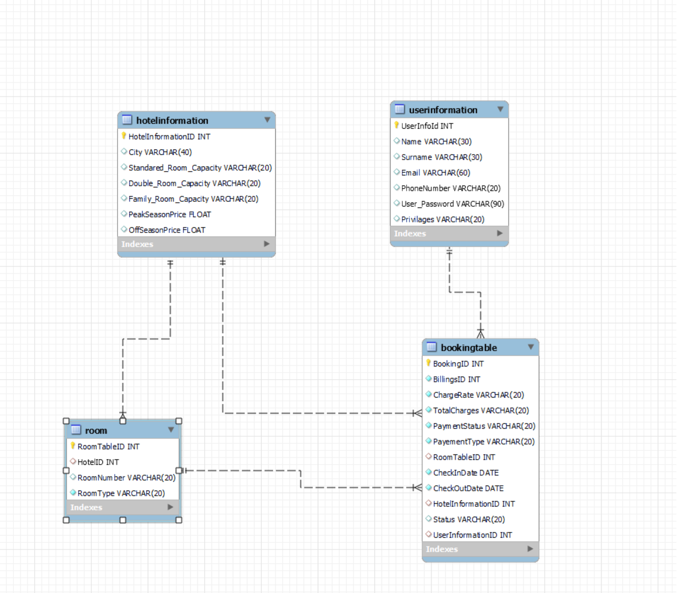
Database Step 2
Tables have been separated, a room
Table was created.

Slide 4
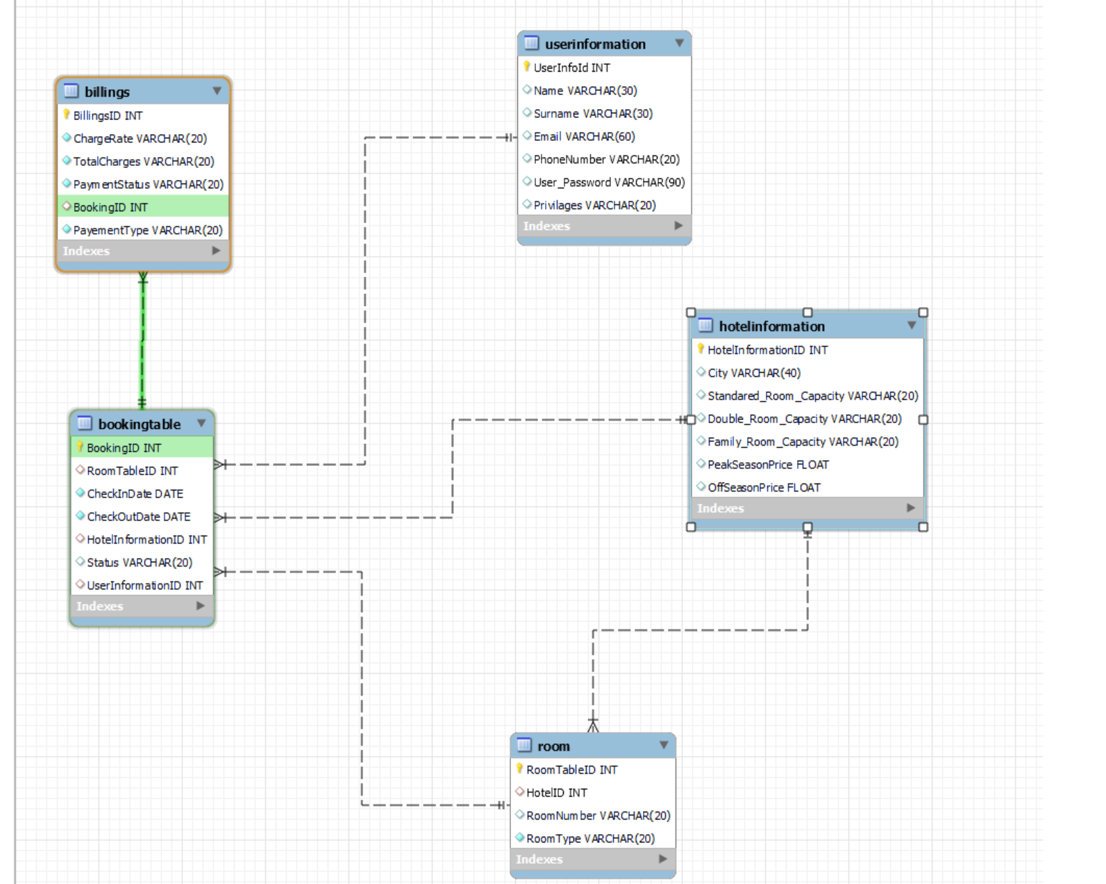
Database Last Step
Non key attributes only rely on primary key attributes
Further separation of tables

Slide 5
LESP issues
Legal:
Code is protected against SQL injections.
Passwords are stored in a hashed format.
Ethical:
Used royalty free images from https://www.pexels.com/
Low number of images to keep running costs low.

Slide 6
LESP issues
Social:
All text is black on white background for readability.
Website is responsive for tablet, phone, and laptop.
Profesional:
Website was tested by me.

Slide 7

Security
SQL Injections:
Use of sessions:
Hashed passwords:

Slide 8
Customer features
Allows user to view bookings.
Allows user to update bookings.
Allows user to delete bookings.

Slide 9
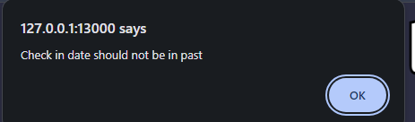
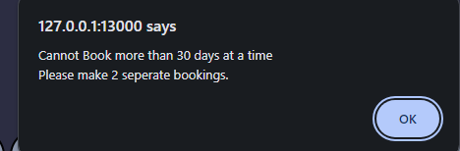
Booking features
User cannot make a booking in the past.
User cannot book for more than 30 days.
User cannot book more than 3 months in advance.
Cancelling a booking 60 days prior to check in doesn’t have a fee
Cancelling within 60 days incurs 50% of the total staying fee
Cancelling within 30 days results in no refunds

Slide 10
Booking Features 2
Different Room types with different costs:
Double is 20% more, double with 2 guests is 30% more, family is 50% more than standard

Slide 11
Admin Features
Can add a hotel
Can delete a hotel
Can update a hotel

Slide 12


Some of the error messages
When the same email is used to register a new account:
When the email or password is incorrect when signing in:

Slide 13
Incomplete or missing features
User cannot download their booking report
Admin cannot update users’ passwords due to an error in the python code
No currency system in place
No specific features given to each hotel
Admin report is lacking, only shows the total revenue.

Slide 14
The End

